Slide 1
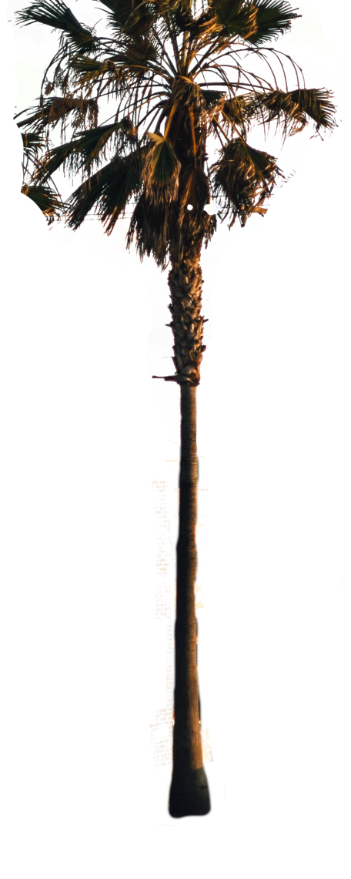
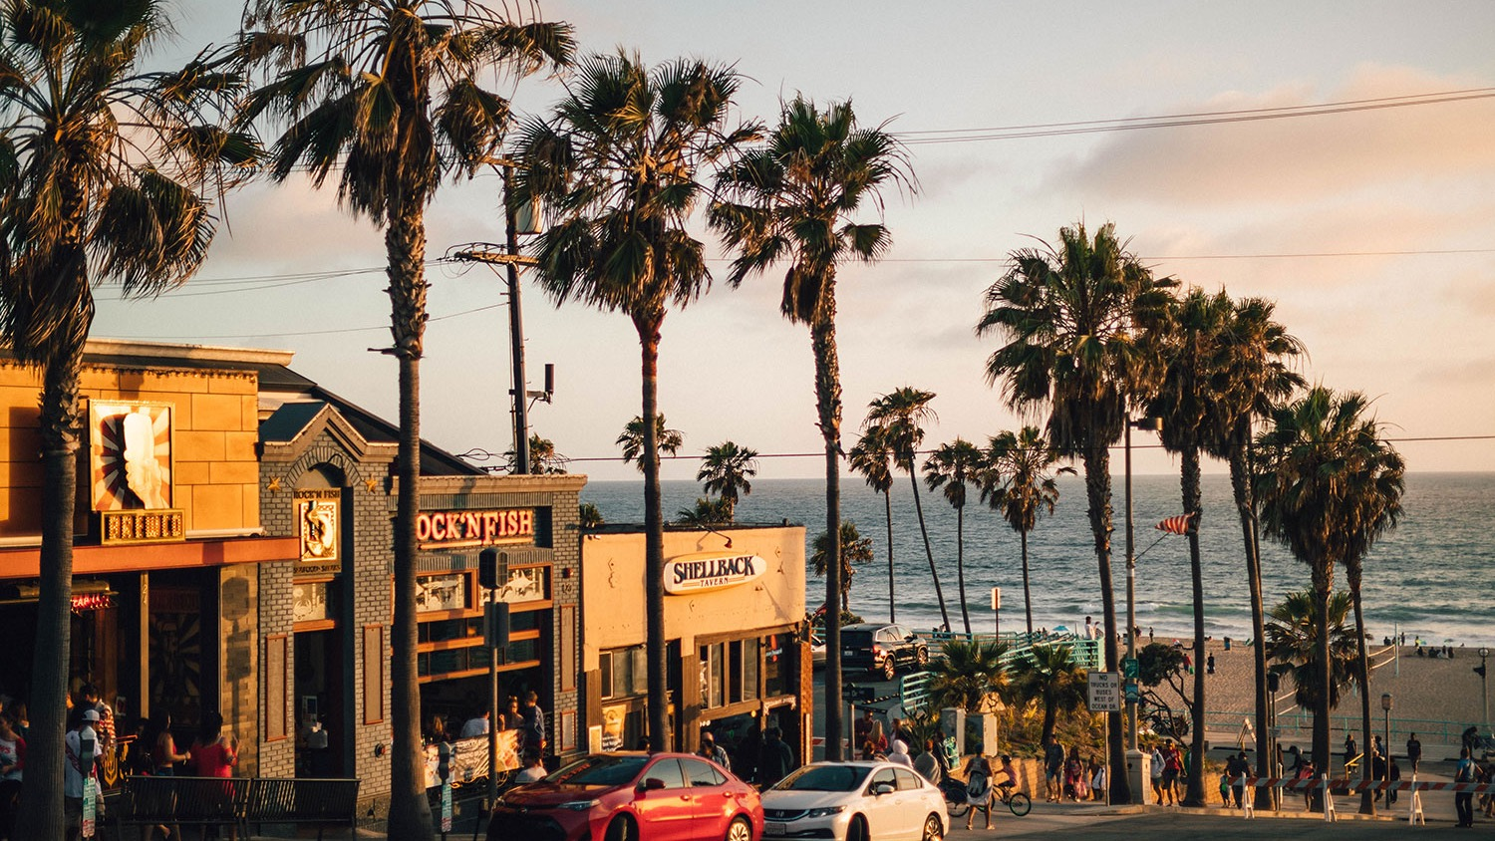

LOS ANGELES
LOS ANGELES
LOS ANGELES
California

Slide 2



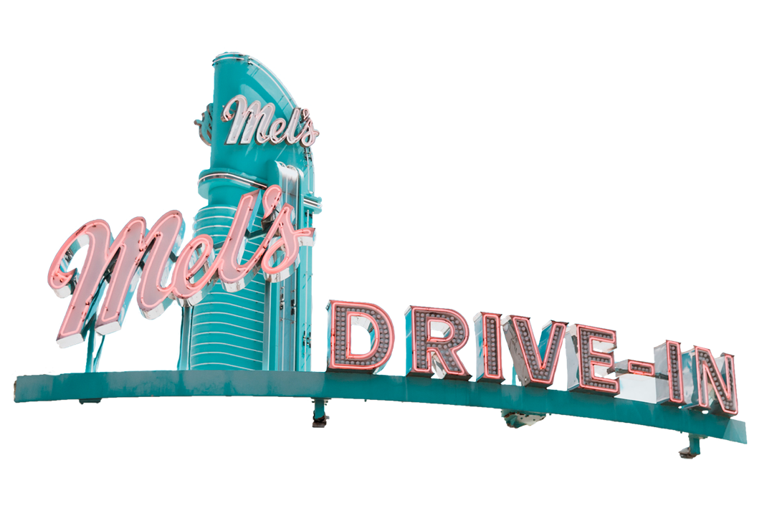

Los Angeles is a city located in Southern California, USA, with a population of over 3.9 million people. It is known for its sunny weather, entertainment industry, and diverse population.
LOS ANGELES
LOS ANGELES
LOS ANGELES
California

Slide 3
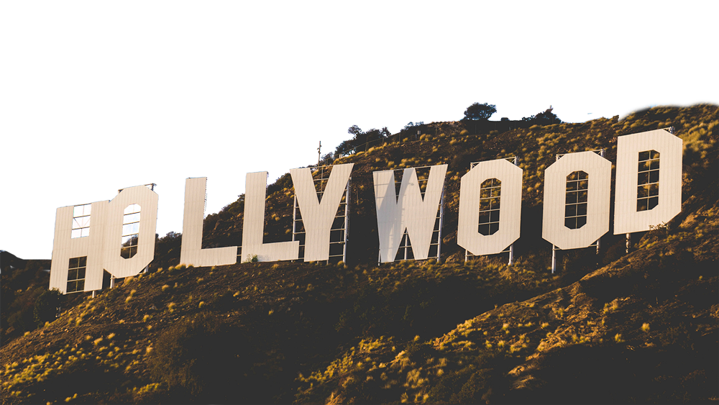
Hollywood is a district in Los Angeles, California. Known as the global center of the entertainment industry, it's home to major movie studios, iconic landmarks like the Hollywood Walk of Fame and the Hollywood Sign, as well as numerous theaters, music venues, and celebrities.
Los Angeles is a city located in Southern California, USA, with a population of over 3.9 million people. It is known for its sunny weather, entertainment industry, and diverse population.
LOS ANGELES
LOS ANGELES
LOS ANGELES
LOS ANGELES

Slide 4


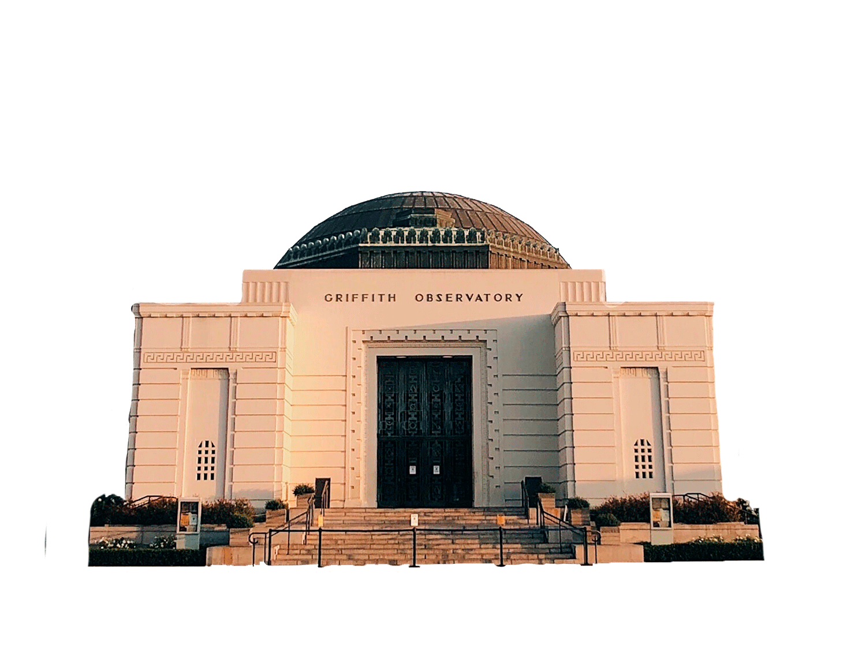
Hollywood is a district in Los Angeles, California. Known as the global center of the entertainment industry, it's home to major movie studios, iconic landmarks like the Hollywood Walk of Fame and the Hollywood Sign, as well as numerous theaters, music venues, and celebrities.
GRIFFITH
GRIFFITH
Observatory
LOS ANGELES
An iconic landmark located in Griffith Park, Los Angeles. It offers stunning views of the city and hosts a variety of astronomy-related exhibits and events.
LOS ANGELES
LOS ANGELES
LOS ANGELES

Slide 5


THANKS FOR
THANKS FOR
THANKS FOR
GRIFFITH
GRIFFITH
Watching
Observatory
An iconic landmark located in Griffith Park, Los Angeles. It offers stunning views of the city and hosts a variety of astronomy-related exhibits and events.

Slide 6

THANKS FOR
THANKS FOR
THANKS FOR
Watching

Slide 7

Credits
This presentation template was created by Slidenest, using resources from these sites:
IMAGES
Pexels: https://www.pexels.com
Unsplash: https://unsplash.com
FONTS
Hanuman: https://fonts.google.com/specimen/Hanuman
Paytone One: https://fonts.google.com/specimen/Paytone+One
Lobster: https://fonts.google.com/specimen/Lobster

